Slide 1
INTRODUCTION TO LINUX
BHAVANA
DAY 3
03/04/2024

Slide 2
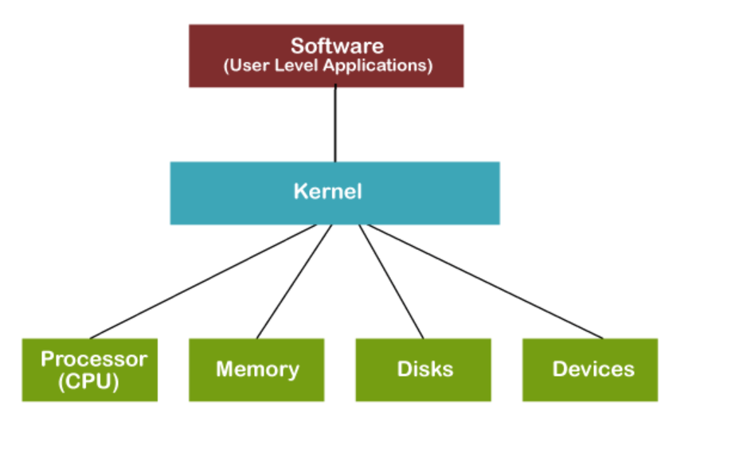
KERNEL

Slide 3
SHELL
► On user log-in, the system runs a shell
► A shell is the environment within which you will interface with the kernel via commands kernel
► It determines the syntax for complex command-line operations and shell scripting
► The shell you're using is called "bash," the successor to the venerable "Bourne Shell" called "sh"

Slide 4
Files and Processes
In Linux, everything is either a file or a process. Meaning everything can be interfaced via the file systems.
▸ Files: text, data, documents, traditional files
▸ Directories: directories are special text files that contain a bunch of other files ▸ Devices: all disks, video hardware, audio hardware, processors, memory, USB ports - all hardware can be interfaced via files
▸ Processes: all running processes can be "seen" via the file system (in /proc) each has a unique identifier (PID)

Slide 5
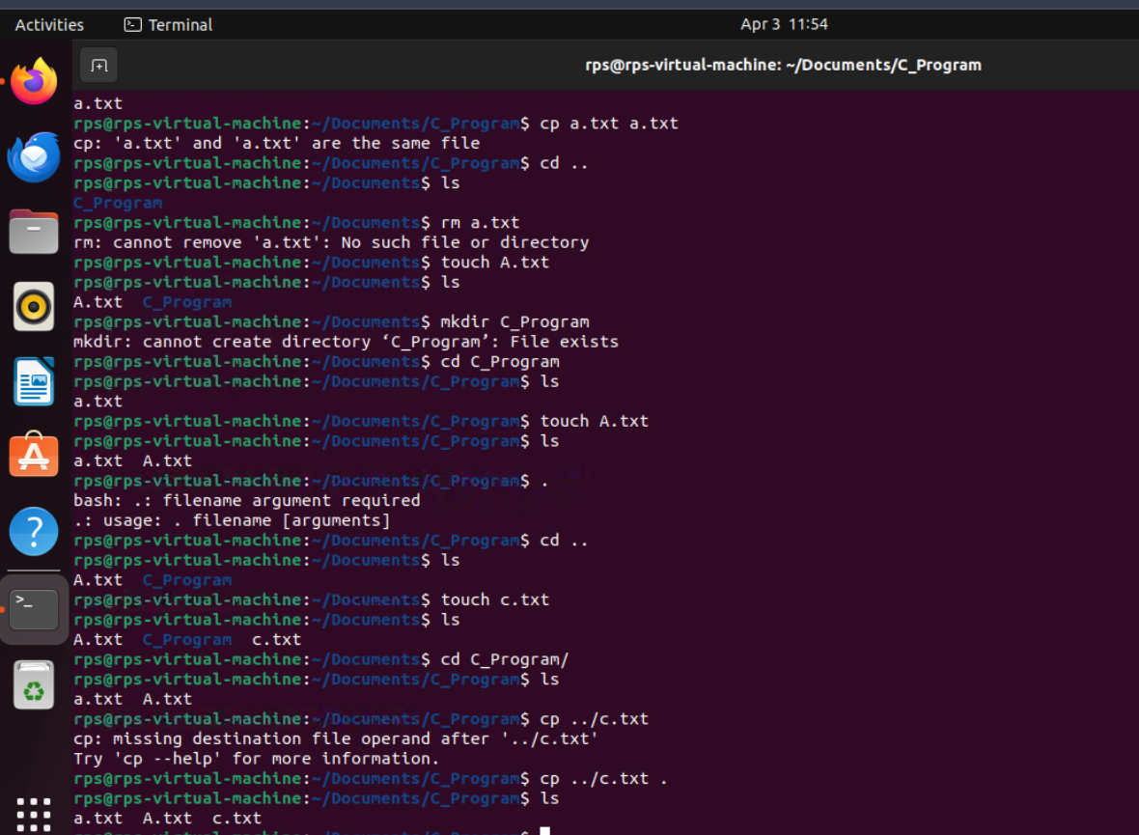
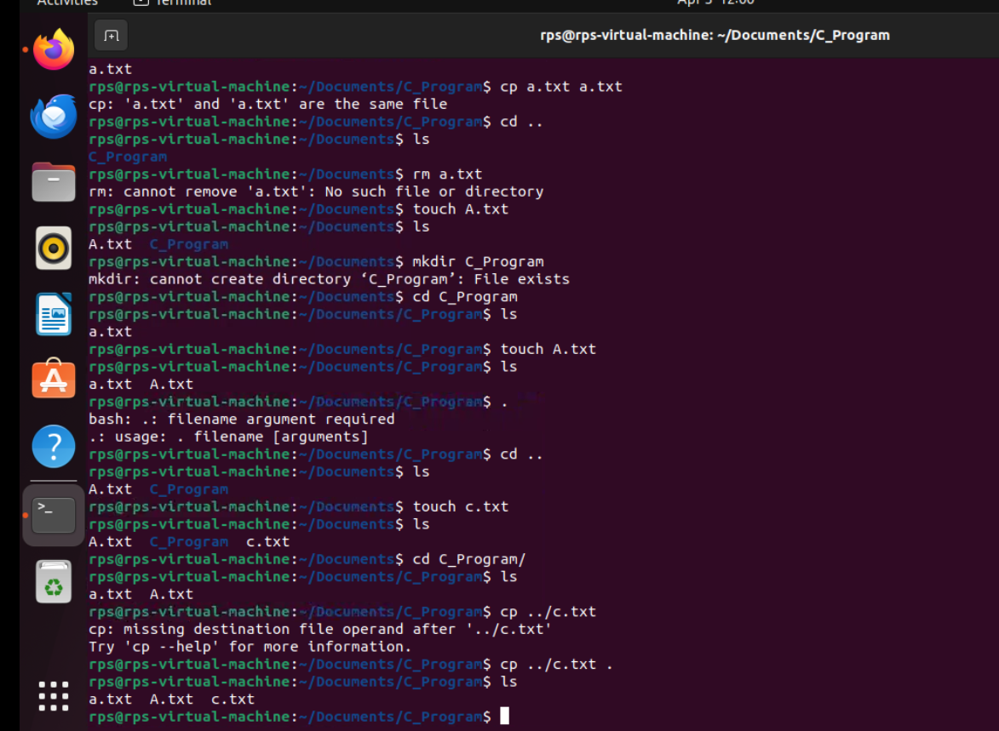
CREATING A DIRECTORY, CREATING FILES, COPYING FILES FROM ONE DRECTORY TO OTHER:

Slide 6
Directories
▸ A directory is a special type of file that can hold other files - often referred to as a folder in Windows or MacOS
▸ The "working directory" is the directory with which your shell is currently associated...where you currently are! When you first login, you will normally be in your home directory, /home/username
▸ Use the 'pwd' command to print working directory
▸ Special directory notations:
▸ . refers to the current working directory
▸.. refers to the parent directory (one level back - the parent directory of /home/username would be /home)

Slide 7
cd and ls commands
► The "cd" command is used to change directory location. Without an argument, "cd" takes you to your home directory
► The "Is" command is used to list the files in a directory. Like many Linux commands, it can take a number of "flags" as options to change the behavior of the command
mkdir : to create new directory
▸ Several ways to get to your home directory: $ cd ~
$ cd $HOME
$ cd /home/username
$ cd /home/$USER
$ cd

Slide 8
ABSOLUTE AND RELATIVE PATH:
$ cd /home/username
# Absolute path:
$ cd /home/username/data
# Relative path:
$ cd data
# Using ~
These do the same:
$ cd ~/data
$ cd /home/username/data

Slide 9
FOR HELP:
ls - -help
man ls
Ownership & Permissions
▸ Files and directories have three types of access permissions:
read permission (r)
write permission (w)
execute permission (x)
▸ Every file and directory has permissions for three levels or entities of permissions:
a) user or owner (denoted by u)
b) group (one or more users denoted by g)
c) others or world (denoted by o)

Slide 10
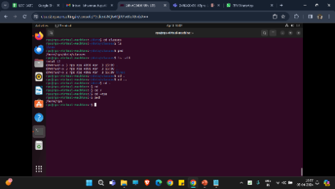
Problem 1 (File system) 1. Use the comands cd, pwd and ls to explore the filesystem.
Try: • cd(change to dir) • pwd (print working directory) • ls (list files in current directory)
• ls -all (list all properties) • cd . (change to here) • cd .. (change one level down) • cd ~ (change to home directory)
• cd (change to home directory) • cd / (change to the root directory - the equivalent to ”C:” in windows)
• change to some other user directory, for instance to username with cd ~username

